Slide 1
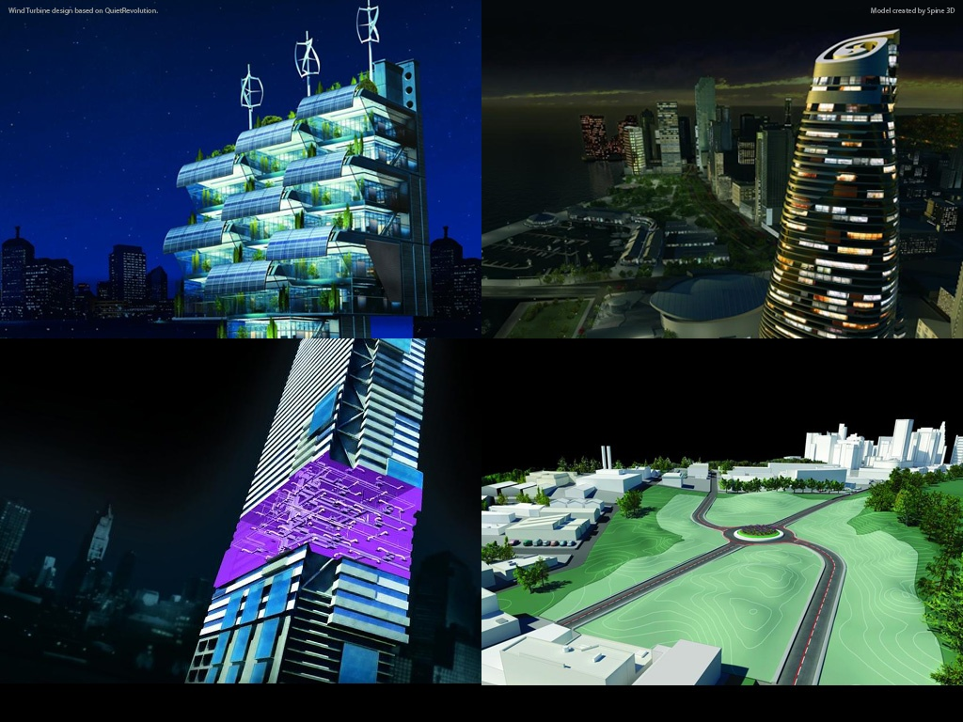
Autodesk AEC Developer’s Camp 2010 Creating & Analyzing Massing Geometry With Revit API
Harry Mattison
Principal Engineer – Revit API Development
Notes:
AEC Title

Slide 2
Conceptual Massing in Revit
Ability to develop complex shapes
Extensive API access to geometry creation, manipulation, and analysis
Use Massing API with geometry, family, and .NET API for wide range of applications
Geometry Creation
Design Aids
Analysis Tools

Slide 3
Reference Points
Construction element for defining a curve’s path
Can be placed using XYZ coordinates
Code example – Points on parabolic curves using NewReferencePoint(xyz) and math functions

Slide 4
Reference Points with Geometric Constraints
Subclasses of PointElementReference
Constrain points to
Edges
Planes
Faces
Edge/edge intersections
Edge/face intersections
Code example – PointOnEdge-based points maintain relative location on edge as it changes

Slide 5
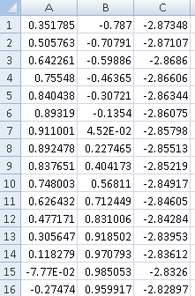
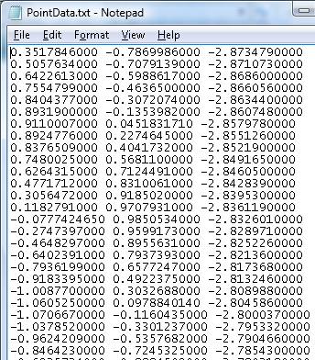
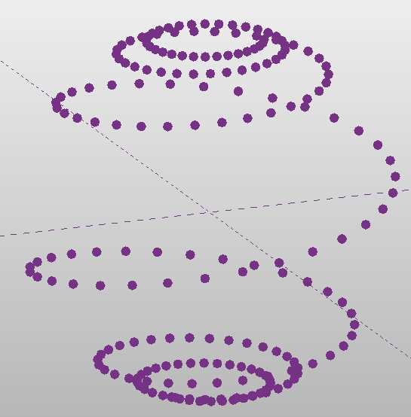
Points from Different Data Sources
From Microsoft Excel From text file

Slide 6
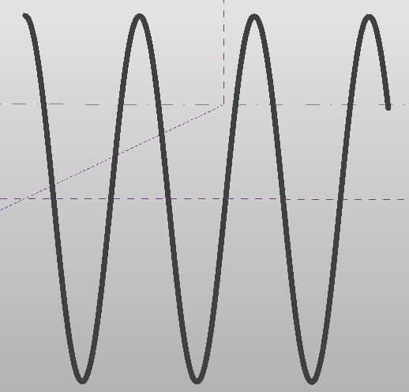
Curve By Points
Collect ReferencePoints into a ReferencePointArray for use by the NewCurveByPoints method.
Code Example:
Sine Curve

Slide 7
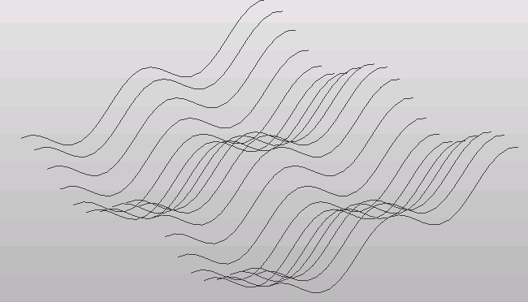
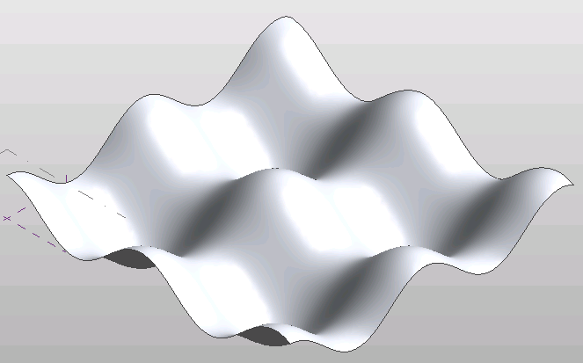
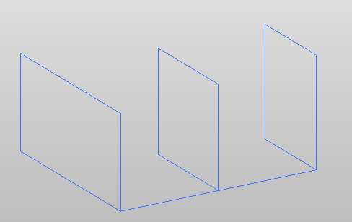
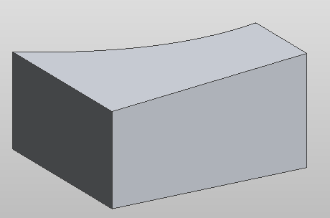
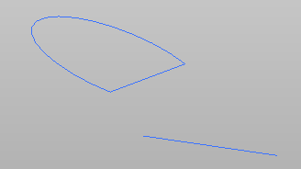
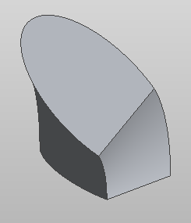
Forms - 2D & 3D shapes from curves
Loft NewLoftForm(bool isSolid,ReferenceArray profiles)
Swept Blend NewSweptBlendForm(bool isSolid, ReferenceArray path, ReferenceArray profiles)
Revolve NewRevolveForm(bool isSolid, ReferenceArray profile, Reference axis, double startAngle, double endAngle)

Slide 8
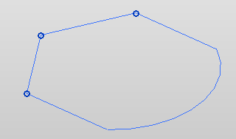
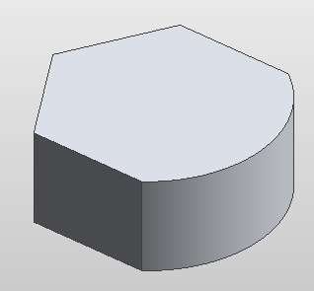
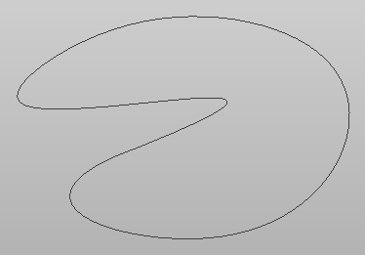
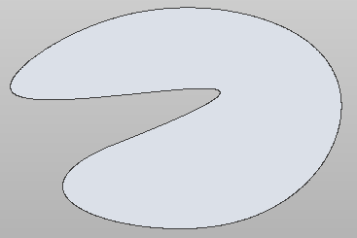
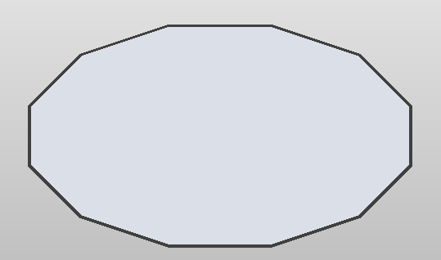
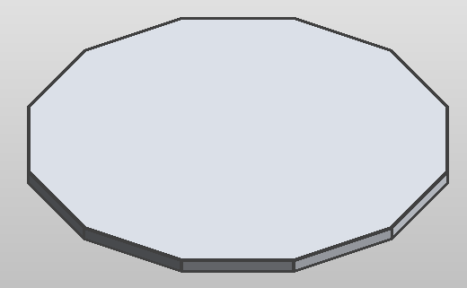
More Form Types
Extrusion NewExtrusionForm(bool isSolid, ReferenceArray profile, XYZ direction)
Cap Surface NewFormByCap(bool isSolid, ReferenceArray profile)
Thickened Surface NewFormByThickenSingleSurface(bool isSolid, Form singleSurfaceForm, XYZ thickenDir)

Slide 9
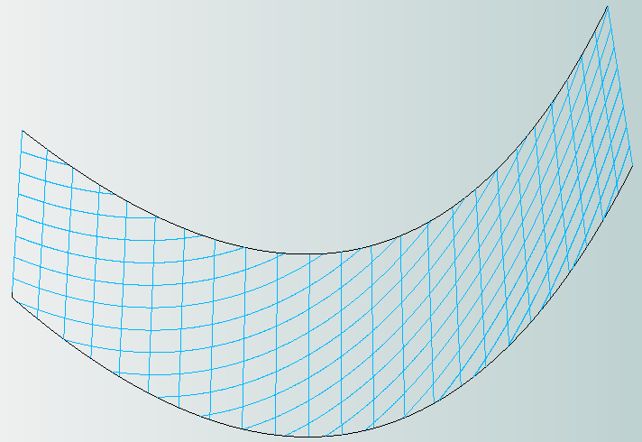
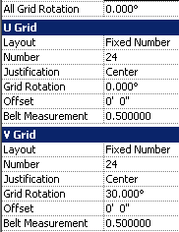
Divided Surface
Creates a grid of parallelograms defined by:
Grid rotation
Spacing in the U & V directions
and other parameters
NewDividedSurface code example:

Slide 10
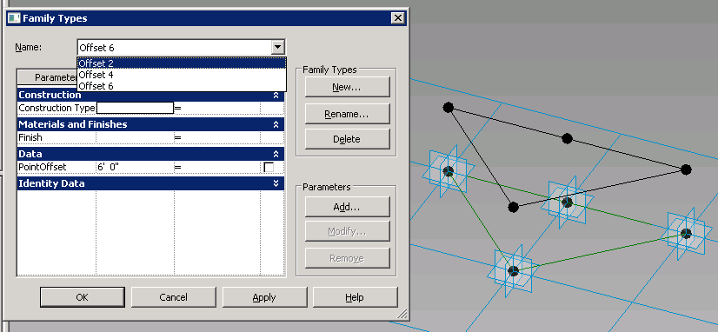
Panel Creation API Tools

Slide 11
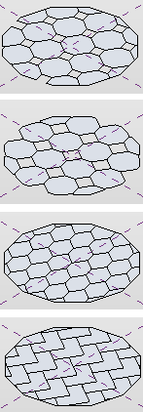
Tile Patterns
Applied to Divided Surfaces
Defines type of panel family that the surface will use
Tile Pattern iteration code sample

Slide 12
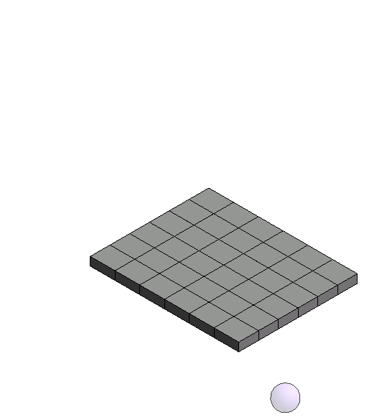
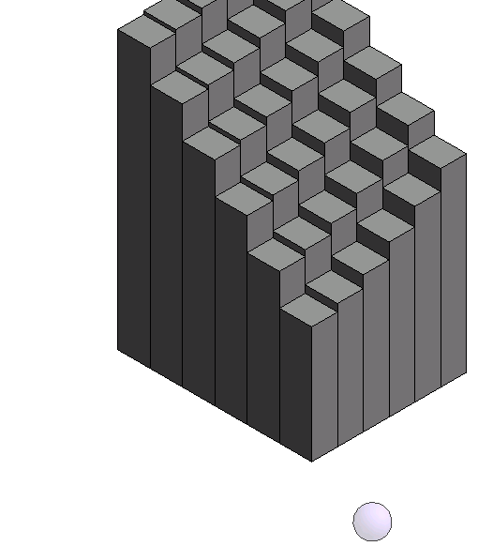
Driving Parameters from Different Data Sources
From Revit Geometry

Slide 13
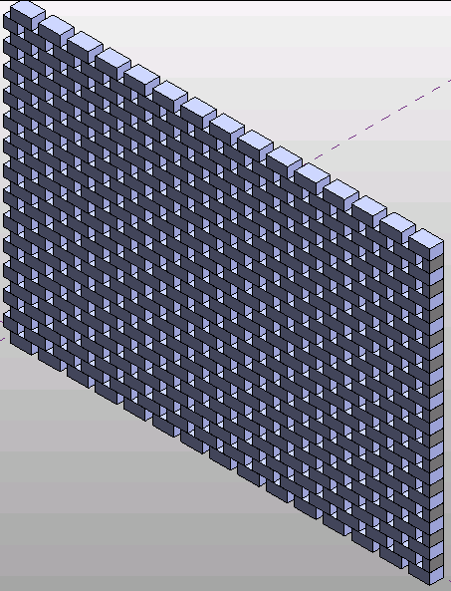
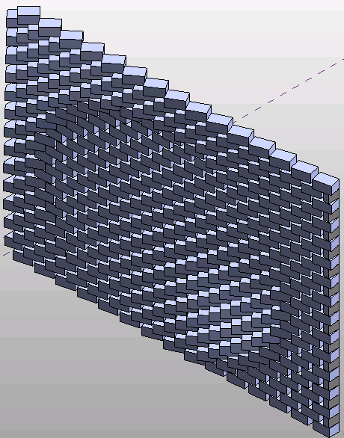
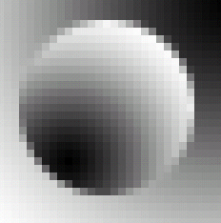
Driving Parameters from Different Data Sources
From Image File

Slide 14
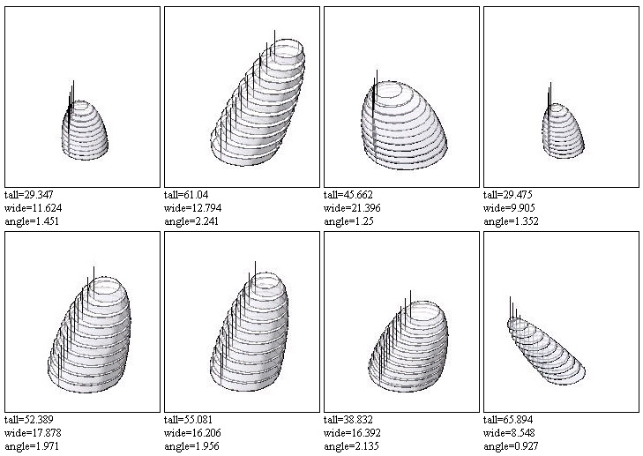
Driving Parameters from Different Data Sources
From random numbers

Slide 15
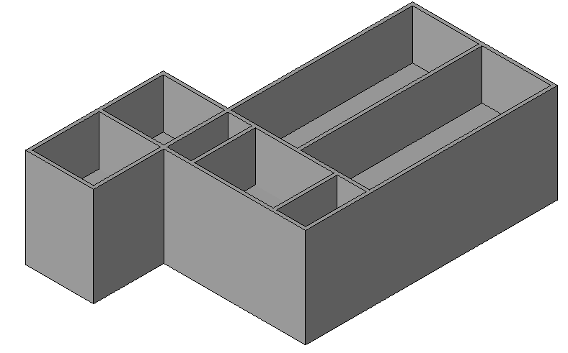
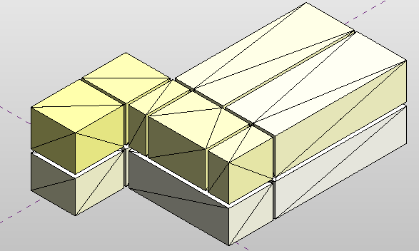
Build Masses From RVT Geometry
Mass Surfaces from Room Boundaries
In the RVT
Get all rooms
Get 3D volume with room.ClosedShell
Create mesh with face.Triangulate()
Find vertices of each triangle in mesh
In the massing family
Create point for each mesh vertex
Create CurveByPoints between these points
Create surfaces through these CurveByPoints using NewFormByCap
Create subcategory and color for the surfaces related to each room.
Mass Surfaces & Levels from RVT to RFA (Context Creator)

